Slide 1

CSE380: Programming in Java Topic: Java Platform Overview

Slide 2
Outlines
[Expected Time: 3 Hours]
Introduction
Why Java?
Where it is used?
Characteristics of Java
Java Platform Editions
Evolution of Java
Understanding JDK, JRE and JVM
How Java is platform-independent
Evaluating Java libraries, middle-ware, and database options

Slide 3
Introduction
Java is a Programming language and a Platform.
Java is a high level, robust, secured and object-oriented programming language.
Developed by Sun Microsystems (James Gosling).
Platform: Any hardware or software environment in which a program runs, is known as a platform.

Slide 4
Why Java?
Java is the Internet Programming Language.
Java enables users to develop and deploy applications on the Internet for servers, desktop computers, and small hand-held devices.

Slide 5
Where it is Used?
According to Sun, 3 billion devices run java.
Desktop Applications such as acrobat reader, media player, antivirus etc.
Web Applications such as irctc.co.in, javatpoint.com etc.
Enterprise Applications such as banking applications.
Mobile Applications
Embedded System, Smart Card, Robotics, Games etc.

Slide 6
Characteristics of Java
Java Is Simple
Java Is Object-Oriented
Java Is Distributed
Java Is Interpreted
Java Is Robust
Java Is Secure
Java Is Architecture-Neutral
Java Is Portable
Java's Performance
Java Is Multithreaded
Java Is Dynamic

Slide 7
Java Platform Editions
A Java Platform is the set of APIs, class libraries, and other programs used in developing Java programs for specific applications.
Notes:
Recognizing that one size doesn’t fit all, Sun has grouped its technologies into three editions.
Java 2 Platform, Standard Edition (J2SE) The J2SE platform is a fast and secure foundation for building and deploying client-side enterprise applications. In today's .com world of nanosecond response times and information gratification, J2SE technology provides the speedy performance and high functionality that is demanded by Web users.
For end users, J2SE technology enables faster and easier use of functionally rich Web applications, such as corporate intranets and interactive shopping aids for e-commerce. For enterprise developers, the improved J2SE technology serves as the base tool for creating sophisticated, valuable applications that can be brought to market quickly.
Java 2 Platform, Enterprise Edition (J2EE) J2EE technology simplifies enterprise applications by basing them on standardized, modular and re-usable components called Enterprise JavaBeans™ (EJB™), providing a complete set of services to those components, and handling many details of application behavior automatically. By automating many of the time-consuming and difficult tasks of application development, J2EE technology allows enterprise developers to focus on adding value, that is, enhancing business logic, rather than building infrastructure.
Java 2 Platform, Micro Edition (J2ME) J2ME technology specifically addresses the vast consumer space, which covers the range of extremely tiny commodities such as smart cards or a pager all the way up to the set-top box, an appliance almost as powerful as a computer. J2ME technology enables device manufacturers, service providers, and content creators to gain a competitive advantage and capitalize on new revenue streams by rapidly and cost-effectively developing and deploying compelling new applications and services to their customers worldwide.
Each edition is a developer treasure chest of tools and supplies that can be used with a particular product.
Note that there are packages developed and supported by Sun that are not part of any edition such as (java3d for 3d graphics).

Slide 8
There are 3 Java Platform Editions:
1. Java 2 Platform, Standard Edition (J2SE)
Core Java Platform targeting applications running on workstations
2. Java 2 Platform, Enterprise Edition (J2EE)
Component-based approach to developing distributed, multi-tier enterprise applications
3. Java 2 Platform, Micro Edition (J2ME)
Targeted at small, stand-alone or connectable consumer and embedded devices

Slide 9
Origin of Java
James Gosling & Patrick Naughton at 1990
Goal : To develop distributed system which is applicable to electronic products(platform independent)
Notes:
자바는 Sun에서 수행된 Green Project 도중 만들어졌다. 자바의 원래 이름은 Oak였다. James Gosling과 Patrick Naughton은 computing의 “next wave”는 digital로 제어되는 가전과 컴퓨터라고 생각해 이에 알맞은 시스템으로 만들어진 것이다.
자바개발의 목적은 연구를 위한 것이 아니라 Product를 만들어 내기 위한 것이었다. 그래서 Star 7(*7)이라는 시스템을 만들어 냈는데 이 시스템은 작은 embedded OS를 가지는 SPARC기반 Hardware이다. (Star 7은 5’’ color LCD를 가지고 touch screen을 input device로 사용하며 무선 네트워킹이 가능한 PDA이다.)
http://java.sun.com/people/jag/green

Slide 10

James Gosling
James Gosling is generally credited as the inventor of the Java programming language
He was the first designer of Java and implemented its original compiler and virtual machine
He is also known as the Father of Java.

Slide 11
Brief History of Java
In 1990, Sun Microsystems began an internal project known as the Green Project to work on a new technology.
In 1992, the Green Project was spun off and its interest directed toward building highly interactive devices for the cable TV industry. This failed to materialize.
In 1994, the focus of the original team was re-targeted, this time to the use of Internet technology. A small web browser called HotJava was written.
Oak was renamed to Java after learning that Oak had already been trademarked.
Notes:
In 1990, Sun Microsystems began an internal project known as the Green Project to work on a new technology. Its team originally considered C++ as the language to use but soon abandoned it for an entirely new language called Oak.
In 1992, the Green Project was spun off and its interest directed toward building highly interactive devices for the cable TV industry. This failed to materialize.
In 1994, the focus of the original team was re-targeted, this time to the use of Internet technology. A small web browser called HotJava was written. Oak was renamed to Java after learning that Oak had already been trademarked.
In 1995, Java was first publicly released
In 1996, Java Development Kit (JDK) 1.0 was released
In 2002, JDK 1.4 (codename Merlin) was released, the most widely used version
In 2004, JDK 5.0 (codename Tiger) was released, the latest version
The name Java was coined at a local coffee shop frequented by some of the members.
It is not clear whether the name is an acronym or not.
However some accounts claim that it stands for the names of James Gosling, Arthur Van Hoff, and Andy Bechtolsheim.
Others, that it is an acronym for Just Another Vague Acronym.

Slide 12
In 1995, Java was first publicly released.
In 1996, Java Development Kit (JDK) 1.0 was released.
In 2002, JDK 1.4 (codename Merlin) was released, the most widely used version.
In 2004, JDK 5.0 (codename Tiger) was released.
The latest version of java is jdk 8.0.

Slide 13
Features of Java(12)

Slide 14
Simple: According to Sun, Java language is simple because syntax is based on C++ and there is Automatic Garbage Collection in java.
2. Object-oriented: We organize our software as a combination of different types of objects that incorporates both data and behaviour.
Basic concepts of OOPs are:
Object
Class
Inheritance
Polymorphism
Abstraction
Encapsulation

Slide 15
3. Platform Independent:
A platform is the hardware or software environment in which a program runs.
There are two types of platforms software-based and hardware-based. Java provides software-based platform.
The Java platform differs from most other platforms in the sense that it is a software-based platform that runs on the top of other hardware-based platforms. It has two components:
Runtime Environment
API(Application Programming Interface)
Java code can be run on multiple platforms e.g. Windows, Linux, Sun Solaris, Mac/OS etc. Java code is compiled by the compiler and converted into bytecode. This bytecode is a platform-independent code because it can be run on multiple platforms i.e. Write Once and Run Anywhere(WORA).

Slide 17
4. Secured: Java is secured because:
No explicit pointer
Java Programs run inside virtual machine sandbox
Classloader: adds security by separating the package for the classes of the local file system from those that are imported from network sources.
Bytecode Verifier: checks the code fragments for illegal code that can violate access right to objects.
Security Manager: determines what resources a class can access such as reading and writing to the local disk.

Slide 18
5. Robust: Robust simply means strong. Java uses strong memory management. There is automatic garbage collection in java. There is exception handling and type checking mechanism in java. All these points makes java robust.
6. Architecture-neutral: There is no implementation dependent features e.g. size of primitive types is fixed.
In C programming, int data type occupies 2 bytes of memory for 32-bit architecture and 4 bytes of memory for 64-bit architecture. But in java, it occupies 4 bytes of memory for both 32 and 64 bit architectures.

Slide 19
7. Portable: We may carry the java bytecode to any platform.
8. High-performance: Java is faster than traditional interpretation since byte code is "close" to native code still somewhat slower than a compiled language (e.g., C++)
9. Distributed: We can create distributed applications in java. RMI and EJB are used for creating distributed applications. We may access files by calling the methods from any machine on the internet.

Slide 20
10. Multi-Threaded: A thread is like a separate program, executing concurrently.
We can write Java programs that deal with many tasks at once by defining multiple threads.
The main advantage of multi-threading is that it doesn't occupy memory for each thread. It shares a common memory area.
Threads are important for multi-media, Web applications etc.

Slide 21
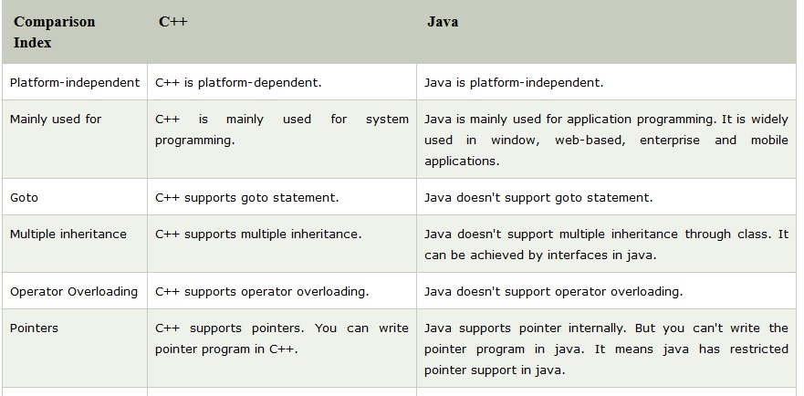
C++ Vs Java

Slide 22
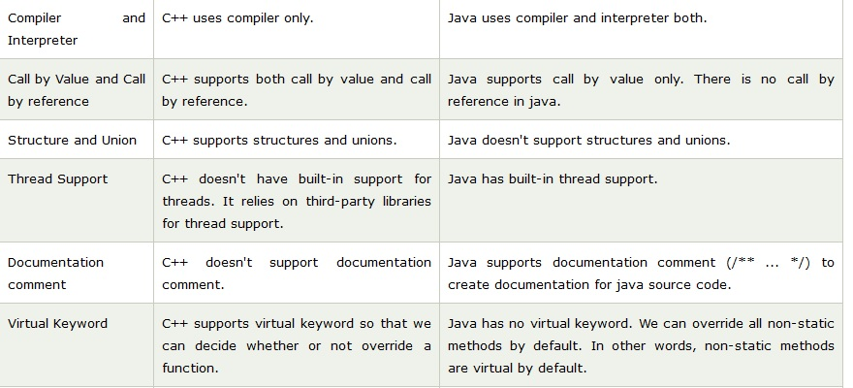
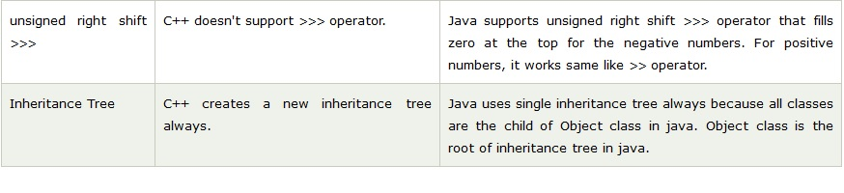

Slide 23
JDK Versions
JDK Alpha and Beta (1995)
JDK 1.0 (23rd Jan, 1996)
JDK 1.1 (19th Feb, 1997)
J2SE 1.2 (8th Dec, 1998)
J2SE 1.3 (8th May, 2000)
J2SE 1.4 (6th Feb, 2002)
J2SE 5.0 (30th Sep, 2004)
Java SE 6 (11th Dec, 2006)
Java SE 7 (28th July, 2011)
Java SE 8 (18th March, 2014)

Slide 24
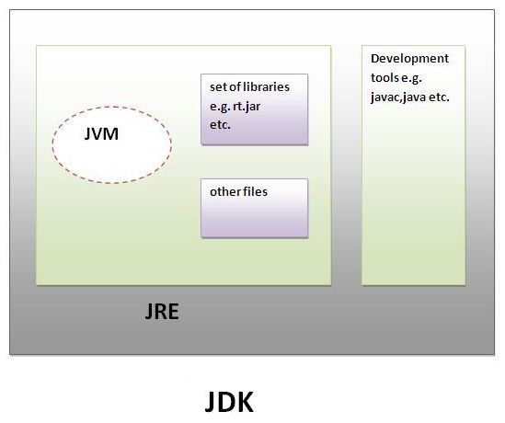
Understanding JDK, JRE and JVM

Slide 25
Understanding JDK & JRE
JDK
JDK is an acronym for Java Development Kit.
It physically exists. It contains JRE and development tools.
JRE
JRE is an acronym for Java Runtime Environment.
It is the implementation of JVM and used to provide runtime environment.
It contains set of libraries and other files that JVM uses at runtime.
Ravi Kant Sahu, Asst. Professor @ Lovely Professional University, Punjab (India)

Slide 26
Understanding JVM
JVM (Java Virtual Machine) is an abstract machine.
It is a specification that provides runtime environment in which java byte code can be executed.
JVMs are available for many hardware and software platforms.
The JVM performs following main tasks:
Loads code
Verifies code
Executes code
Provides runtime environment

Slide 27
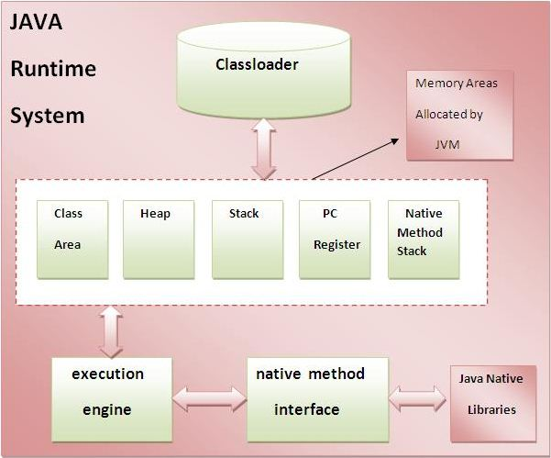
Internal Architecture of JVM

Slide 28

How Java is Platform-independent?

Slide 29
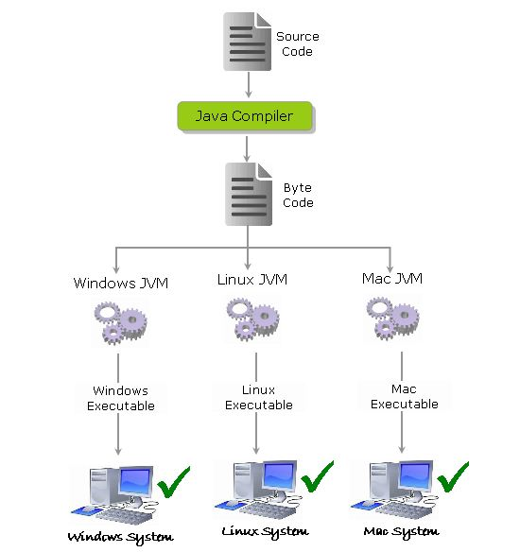
How Java is Platform-independent?

Slide 30
How Java is Platform-independent?
The source code (program) written in java is saved as a file with .java extension.
The java compiler “javac” compiles the source code and produces the platform independent intermediate code called BYTE CODE. It is a highly optimized set of instructions designed to be executed by the JVM.

Slide 31
How Java is Platform-independent?
The byte code is not native to any platform because java compiler doesn’t interact with the local platform while generating byte code.
It means that the Byte code generated on Windows is same as the byte code generated on Linux for the same java code.
The Byte code generated by the compiler would be saved as a file with .class extension. As it is not generated for any platform, can’t be directly executed on any CPU.

Slide 32
Portability Vs Platform Independence
Portability focuses on adaptation of software in various OS, by recompiling the source to make the binary compatible with the target OS and not necessarily modifying the source.
Platform independence focuses on ability of software to run on VIRTUAL hardware that in turn interfaces with the PHYSICAL hardware.
Examples of cross-platform or platform independent languages are Python, JavaScript, Java etc.

Slide 33
Java Libraries, Middle-ware, and Database options
java.lang
java.util
java.sql
java.io
java.nio
java.awt
javax.swing

Slide 34
Java Libraries, Middle-ware, and Database options
java.lang
Provides classes that are fundamental to the design of the Java programming language.
Following are the important Classes in java.lang package:
Boolean: The Boolean class wraps a value of the primitive type boolean in an object.
Byte: The Byte class wraps a value of primitive type byte in an object.
ClassLoader: A class loader is an object that is responsible for loading classes.
Integer: The Integer class wraps a value of the primitive type int in an object.
Object: Class Object is the root of the class hierarchy.
String: The String class represents character strings.
Thread: A thread is a thread of execution in a program.
Math: The class Math contains methods for performing basic numeric operations such as the elementary exponential, logarithm, square root, and trigonometric functions.

Slide 35
Java Libraries, Middle-ware, and Database options
java.util
It contains the collections framework, legacy collection classes, event model, date and time facilities, internationalization, and miscellaneous utility classes (a string tokenizer, a random-number generator, and a bit array).
Following are the Important Classes in Java.util package :
AbstractCollection: This class provides a skeletal implementation of the Collection interface, to minimize the effort required to implement this interface.
AbstractQueue: This class provides skeletal implementations of some Queue operations.
Currency: Represents a currency.
Date: The class Date represents a specific instant in time, with millisecond precision.

Slide 36
Java Libraries, Middle-ware, and Database options
java.sql
This package include classes and interface to perform almost all JDBC operation such as creating and executing SQL Queries.
Following are the Important Classes in java.sql package :
java.sql.Connection: creates a connection with specific database
java.sql.CallableStatement: Execute stored procedures
java.sql.Date: Provide support for Date SQL type.
java.sql.Driver: create an instance of a driver with the DriverManager.
java.sql.DriverManager: This class manages database drivers.
Notes:
Database Driver JDBC, ODBC

Slide 37
Java Libraries, Middle-ware, and Database options
java.io
Java I/O (Input and Output) is used to process the input and produce the output.
Java uses the concept of stream to make I/O operation fast. The java.io package contains all the classes required for input and output operations.
Following are the Important Classes in java.io package :
OutputStream
Java application uses an output stream to write data to a destination, it may be a file, an array, peripheral device or socket.
InputStream
Java application uses an input stream to read data from a source, it may be a file, an array, peripheral device or socket.
System.out: standard output stream
System.in: standard input stream
System.err: standard error stream
Notes:
Database Driver JDBC, ODBC

Slide 38
Java Libraries, Middle-ware, and Database options
java.nio
Java has provided a second I/O system called NIO (New I/O).
Java NIO provides the different way of working with I/O than the standard I/O API's.
It is an alternate I/O API for Java (from Java 1.4).It supports a buffer-oriented, channel based approach for I/O operations.
With the introduction of JDK 7, the NIO system is expanded, providing the enhanced support for file system features and file-handling.
Due to the capabilities supported by the NIO file classes, NIO is widely used in file handling.
Notes:
Database Driver JDBC, ODBC

Slide 39
Java Libraries, Middle-ware, and Database options
java.awt
JavaAWT (Abstract Window Toolkit) is an API to develop GUI or window-based applications in java.
Java AWT components are platform-dependent i.e. components are displayed according to the view of operating system. AWT is heavyweight i.e. its components are using the resources of OS.
The java.awt package provides classes for AWT api such as TextField, Label, TextArea, RadioButton, CheckBox, Choice, List etc.
.
Notes:
Database Driver JDBC, ODBC

Slide 40
Java Libraries, Middle-ware, and Database options
java.swing
Java Swing is a part of Java Foundation Classes (JFC) that is used to create window-based applications. It is built on the top of AWT (Abstract Windowing Toolkit) API and entirely written in java.
Unlike AWT, Java Swing provides platform-independent and lightweight components.
The javax.swing package provides classes for java swing API such as JButton, JTextField, JTextArea, JRadioButton, JCheckbox, JMenu, JColorChooser etc.
.
Notes:
Database Driver JDBC, ODBC

Slide 41


